Slide 1
Department of Electrical and Electronics Engineering
ANNA UNIVERSITY REGIONAL CAMPUS COIMBATORE
EE3811 & PROJECT WORK THIRD REVIEW Title of the project :
SMART ASSISTANCE SYSTEM FOR MARITIME BORDER
SECURITY AND FISHERMEN NAVIGATION
Date : 14.05.2025
Project Guide Name/Designation: | Dr.M.Newlin Rajkumar/Assistant Professor/ EEE
Name and Regn. Number of Students: | S.Anbarasu (710021105006) R.Mohanraj (710021105027) M.Selvanagarajan (710021105035)

Slide 2
AGENDA
INTRODUCTION
PROBLEM STATEMENT
OBJECTIVE
LITERATURE REVIEW
EXISTING METHOD
PROPOSED METHOD
BLOCK / CIRCUIT DIAGRAM
TIMELINE
CONCLUSION
REFERENCES

Slide 3
INTRODUCTION
Fishermen often unknowingly cross international maritime borders, leading to serious legal and security issues.
This project aims to develop a smart IoT-based system that tracks fishing boats using GPS and alerts them when they approach or cross the border.
The system will also notify authorities onshore and automatically reduce boat speed in restricted zones to prevent further violations.

Slide 4
PROBLEM STATEMENT
Unintentional border crossings by fishermen can result in arrests, penalties, and diplomatic tensions.
Traditional methods, such as relying on experience or physical markers, are ineffective in open waters.
There is a need for a real-time tracking and alert system that ensures fishermen stay within legal boundaries while also informing authorities in case of violations

Slide 5
OBJECTIVE
To develop an IoT-based system that continuously monitors the location of fishing boats.
To provide real-time alerts to fishermen using LED indicators and buzzers when they approach the border.
To notify coastal authorities about any border violations.
To automatically reduce the speed of the boat if it enters a restricted zone.

Slide 6
LITERATURE REVIEW
Contd..
S. No. | Title and Author | Name of the Journal and Year of Publication | Remarks
1 | IoT Assisted Fisherman Aid to Detect Borders and Alert System by using Intelligent GPS Technology AP.Ramesh, R Nithya Paranthaman, M Porkodi, Varna, S Rohini | 2023 International Conference on Innovative Computing, Intelligent Communication and Smart Electrical Systems (ICSES) | The fishermen are alerted when they get close to the first two borders by a loudspeaker (which acts as a siren) and an indicator that has an LCD. In the event that the warning system is unsuccessful, there is a backup option. The boat's engine will automatically turn off when it gets closer to the third border as it travels.
2 | Border Alerting System using IOT Kalpana R A, Ragul R,Kaushiik B,Siva Sankar C | 2024 International Conference on Communication, Computing and Internet of Things (IC3IoT) | The project develops a system to monitor and alert fishermen to potential hazards by utilizing sophisticated technology and a community-based approach. By using buoys to broadcast the signal, a radio frequency suitable for line-of-sight communication across water and modest distances is utilized.
3 | Enhancing Fisherman’s Safety with Border Alerting System J Manikandan,K Makesh Kumar,V Mangaiyarkarasi,E Jaya Prakash, M Anand | 2024 International Conference on Communication, Computing and Internet of Things (IC3IoT) | The Fisherman Border Notifications initiative aims to enhance the safety and security of India’s coastal fishermen by providing them with real-time notifications on border security, piracy, and potential hazards.

Slide 7
4 | Smart Border Surveillance System using Wireless Sensor Network and Computer Vision Neha Bhadwal,Vishu Madaan,Prateek Agrawal,Awadesh Shukla,Anuj Kakran | 2019 International Conference on Automation, Computational and Technology Management (ICACTM) | Border surveillance is crucial for national defense and security, ensuring the safety of citizens by monitoring borders 24/7 to prevent threats like terrorist infiltrations and illegal movements. Currently, border security forces manually monitor vast and harsh terrains, requiring significant manpower and resources, making the process difficult and risky for human personnel. Implementing automated surveillance systems can reduce human involvement in hostile conditions, detect threats, send alerts, and assist defense forces, improving security while minimizing risks and resource usage.
5 | A New Era in Fishing Safety: RF and GSM Technologies R Pramodhini, K Kadambari, S R Bhavana Nishchith , M Krishna | 2024 International Conference on Recent Advances in Science and Engineering Technology (ICRASET) | The system uses RF technology for accurate boundary detection, GSM-based communication for real-time distress signaling, and weather monitoring to enhance safety, alerting fishermen of border proximity and emergencies. By integrating navigation, distress alerts, and weather tracking, the system improves operational efficiency, ensures compliance with maritime laws, and enhances safety while protecting livelihoods and the marine environment.

Slide 8
EXISTING METHOD
The system utilizes GPS to track the boat's exact location, ensuring that fishermen remain within permitted areas. If they cross a boundary, an alarm is triggered, alerting them immediately.
Wireless Sensor Network (WSN) technology allows communication between the boat and an IoT-based system, sending alerts through a loudspeaker and an LCD indicator as the fishermen near boundaries.
If the warning system fails, a backup mechanism shuts off the boat’s engine near the final border, preventing further movement. Additionally, both the Indian and Sri Lankan governments can access the data for better monitoring.

Slide 9
PROPOSED METHOD
The system leverages cutting-edge IoT technology to continuously monitor and precisely track the movement of fishing vessels. It provides real-time alerts to fishermen when they approach or cross international maritime borders, ensuring regulatory compliance and enhanced safety at sea.
By integrating Long Range Wide Area Network (LoRaWAN) technology, the system facilitates seamless, long-range, and low-power communication between fishing boats and coastal authorities. This ensures immediate intervention, swift decision-making, and enhanced security for fishermen operating near restricted maritime zones.
The system is designed to automatically regulate and reduce the speed of fishing vessels as they approach restricted or high-risk maritime areas. This proactive measure prevents unintentional trespassing, safeguards fishermen from potential legal issues, and reinforces maritime security protocols.

Slide 10
BLOCK DIAGRAM
ARDUINO UNO
LORAWAN MODULE
NEO-6M GPS MODULE
LCD DISPLAY
POWER SUPPLY
MOTOR DRIVE CONTROL
BUZZER & LED

Slide 11
EXPECTED OUTCOME
A functional IoT-based system that accurately tracks
and alerts fishermen about border crossings.
Effective communication between the boats and
coastal authorities via LoRaWAN.
Automatic speed reduction of boats when entering
restricted zones.
A cost-effective and scalable solution for maritime
border security

Slide 12
TIMELINE
S.No | Timeline | Works
1 | Week 1 – 2 Mar 2025 | Project confirmation and Domain Overview. Collecting of Survey, Problem Identification and Solution
2 | Week 3 – 4 Mar 2025 | Software and Hardware Requirements confirmation and collect the hardware components and software packages.
3 | Week 1 - 2 Apr- 2025 | Installing software and check the basic sensor codes. Design the hardware and test with basic codes Collect the existing project information for documentation
4 | Week 3 – 4 Apr – 2025 | Complete the software side and test with the hardware. Try with different scenario of sensor input.
5 | Week 1 - 2 May – 2025 | Report and Technical Documentation Journal Work – Journal Publication

Slide 13
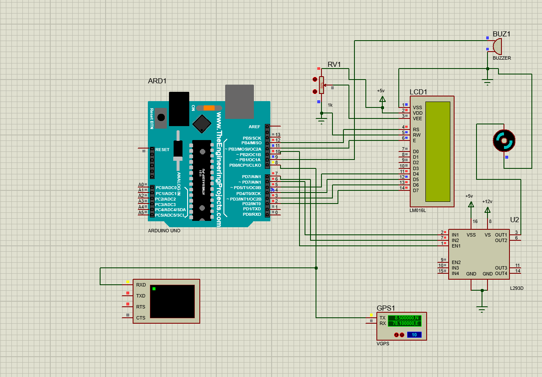
SIMULATION RESULTS
GPS COORDINATES - REALTIME

Slide 14
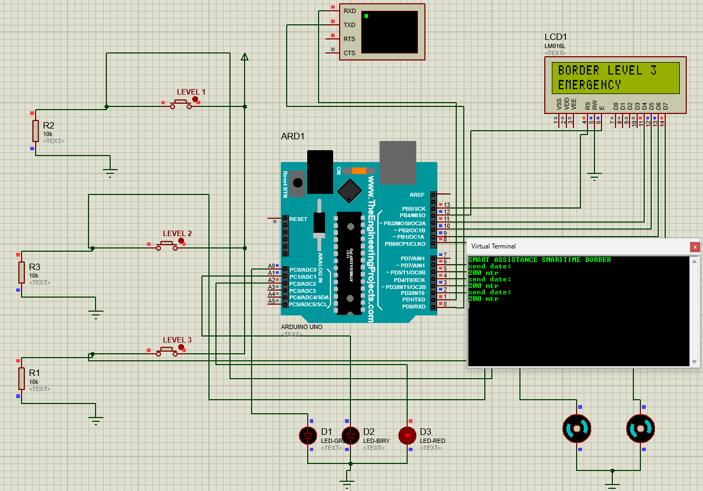
SIMULATION RESULTS
GPS COORDINATES - MANUAL

Slide 15
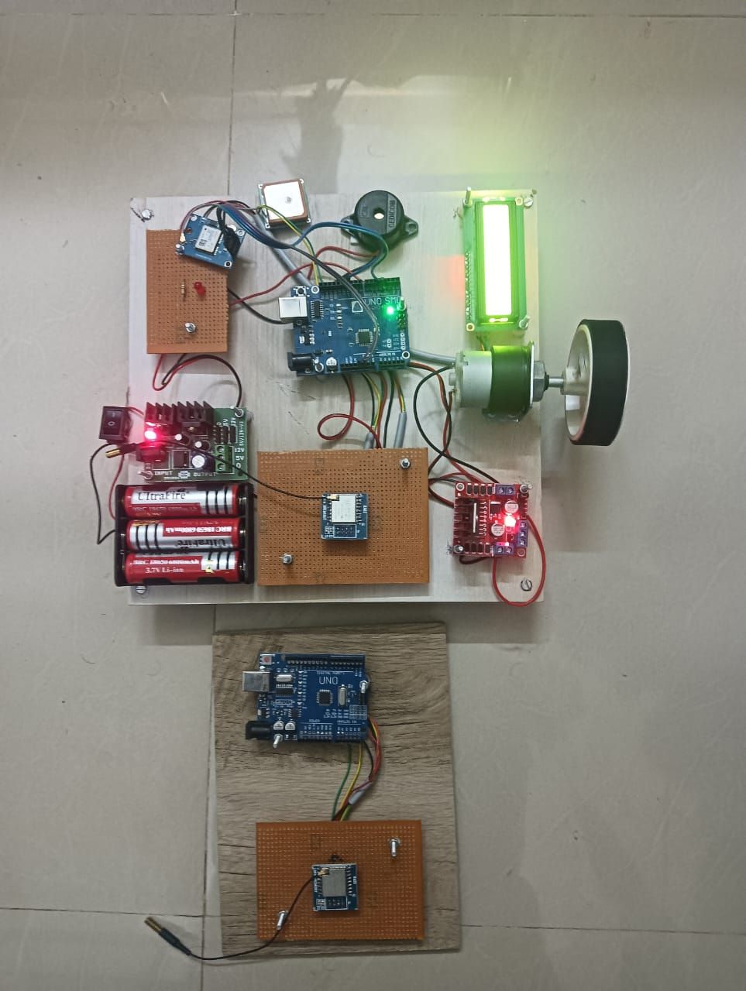
HARDWARE RESULTS

Slide 16
CONCLUSION
Unintentional border crossings pose legal, safety, and diplomatic risks.
Traditional navigation methods are unreliable in open waters.
The IoT-based system provides real-time location tracking and alerts to fishermen and authorities.
Automated speed control enhances safety and prevents violations.

Slide 17
REFERENCES
Ref.1-IoT Assisted Fisherman Aid to Detect Borders and Alert System by using Intelligent GPS Technology
AP. Ramesh;R. Nithya Paranthaman;M. Porkodi;V. Aruna;S. Rohini2023 International Conference on Innovative Computing, Intelligent Communication and Smart Electrical Systems (ICSES)
Ref.2-Border Alerting System using IOT
Kalpana R A;Ragul R;Kaushiik B;Siva Sankar C2024 International Conference on Power, Energy, Control and Transmission Systems (ICPECTS)
Ref.3-Enhancing Fisherman’s Safety with Border Alerting System
J Manikandan;K Makesh Kumar;V. Mangaiyarkarasi;E Jaya Prakash;M Anand
2024 International Conference on Communication, Computing and Internet of Things (IC3IoT)
Ref.4- Smart Border Surveillance System using Wireless Sensor Network and Computer Vision
Neha Bhadwal;Vishu Madaan;Prateek Agrawal;Awadesh Shukla;Anuj Kakran 2019 International Conference on Automation, Computational and Technology Management (ICACTM)
Ref.5- A New Era in Fishing Safety: RF and GSM Technologies
R Pramodhini;K Kadambari;S R Bhavana;Nishchith M Krishna 2024 International Conference on Recent Advances in Science and Engineering Technology (ICRASET)

Slide 18
THANK YOU

